Slide 1
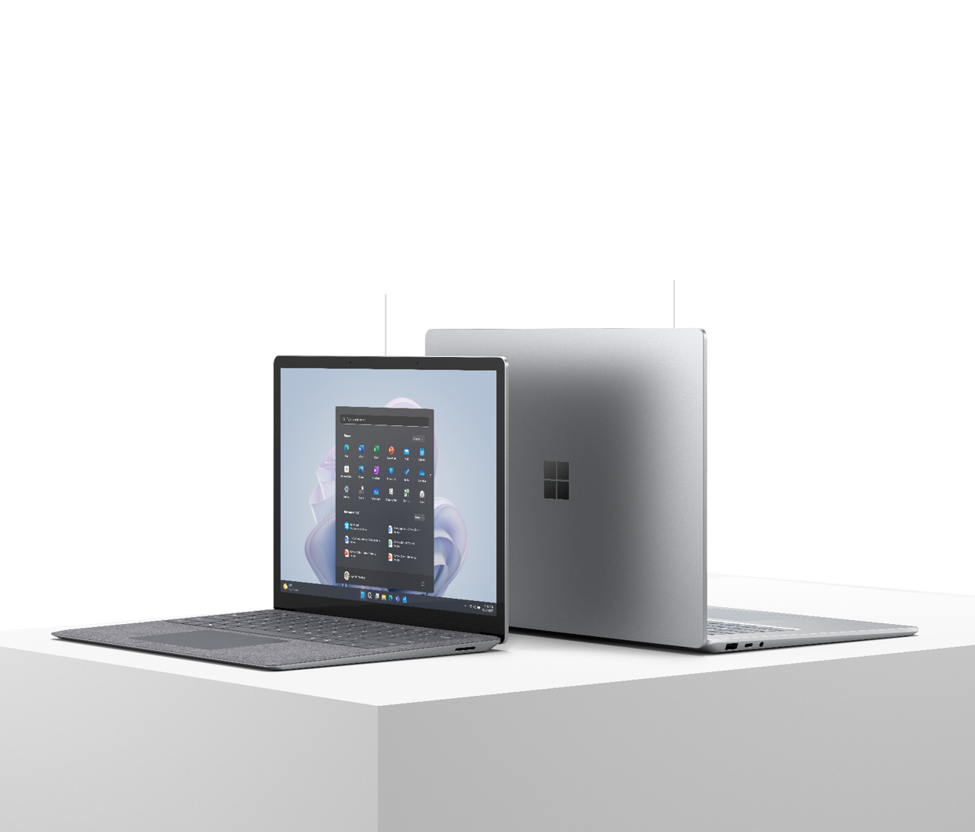
Microsoft Surface Laptop 5
Super powered for serious work​
When your team’s work speaks for itself, things can get loud. With lightning-fast performance, sleek portability, true-to-life video calls, PixelSense™ touchscreen display, and built-in security, Microsoft Surface Laptop 5 enables your team to do what it does best: Deliver impact with speed and performance.
BENEFITS
Feel like you're face-to-face with clients and coworkers in flattering, true-to-life video with great low-light capabilities. |  | Give IT peace of mind knowing that your company, customer, and employee data are safe and secure with Windows 11 Secured-core PC, featuring a removable hard drive for data retention. |  | Some days there's just no time to waste. Get back to work within seconds of opening the lid with Instant On. Plus, sign in securely with Windows Hello password-free sign-in.
Enhanced camera experiences, powered by Windows 11
15” Aluminum casing in Platinum
Ultra-vivid colors with Dolby Vision®
Versatile Thunderbolt™ 4 connectivity
13.5” PixelSense™ touchscreen for ultra-portable productivity
13.5” with Alcantara® material palm rest

Slide 2
Microsoft Surface Laptop 5
SIZE AND WEIGHT |  | Surface Laptop 5 13.5”: Length: 12.1 inch (308 mm) Width: 8.8 inch (223 mm) Height: .57 inch (14.5 mm) Weight: Fabric 2.80 lbs (1,272 g) Metal 2.86 lbs (1,297 g) Surface Laptop 5 15”: Length: 13.4 inch (340 mm) Width: 9.6 inch (244 mm) Height: .58 inch (14.7 mm) Weight: 3.44 lbs (1,560 g) |  | PROCESSOR |  | Surface Laptop Laptop 5 13.5” 12th Gen Intel® Core™ i5-1245U processor 12th Gen Intel® Core™ i7-1265U processor Built on the Intel® Evo™ platform Surface Laptop Laptop 5 15” 12th Gen Intel® Core™ i7-1265U processor Built on the Intel® Evo™ platform
KEYBOARD LAYOUT |  | Activation: Moving keys Layout: QWERTY, full row of function keys (F1 – F12) Windows key and dedicated buttons for media controls, screen brightness Keyboard backlight |  | BATTERY LIFE¹⁴ |  | Surface Laptop Laptop 5 13.5” Up to 18 hours of typical device usage Surface Laptop Laptop 5 15” Up to 17 hours of typical device usage
ENERGY USAGE (JAPAN ONLY) |  | 13.5” Surface Laptop Laptop 5, Intel 構成： 12区分 12.4kWh/年(AAA) 15” Surface Laptop Laptop 5, Intel 構成： 12区分 12.8kWh/年(AAA) |  | SUSTAINABILITY¹² |  | Meets ENERGY STAR® requirements Registered EPEAT® Gold in the US and Canada¹³ Sustainable Products & Solutions | Microsoft CSR
SENSORS |  | Ambient light sensor |  | WARRANTY¹⁵ |  | 1-year limited hardware warranty
Select SKUs built on the Intel® Evo™ Platform
15” with metal palm rest

Slide 3
Microsoft Surface Laptop 5
SERVICEABILITY² |  | Replaceable components include: SSD AB Cover module (display) C Cover Battery + Bucket Motherboard Charging Port (Surflink connector) Thermal Module Thermal pad and Desense tape Feet |  | ACCESSIBILITY |  | Compatible with Surface Adaptive Kit Compatible with Surface Delray Include Windows Accessibility Feature – Learn More Accessibility Features | Microsoft Accessibility Discover more Microsoft Accessible Devices & Products Accessible Devices & Products for PC & Gaming | Assistive Tech Accessories - Microsoft Store
RADIO FREQUENCY (FRANCE ONLY)¹⁶ |  | 1950 (Intel® 13.5” Alcantara® material) Le débit d’absorption spécifique (DAS) local quantifie l’exposition de l’utilisateur aux ondes électromagnétiques de l’équipement concerné. Le DAS maximal autorisé est de 1.0 W/kg pour le tronc 1951 (Intel® 13.5” Boîtier: aluminum) Le débit d’absorption spécifique (DAS) local quantifie l’exposition de l’utilisateur aux ondes électromagnétiques de l’équipement concerné. Le DAS maximal autorisé est de 1.0 W/kg pour le tronc 1979 (Intel® 15” Boîtier: aluminum) Le débit d’absorption spécifique (DAS) local quantifie l’exposition de l’utilisateur aux ondes électromagnétiques de l’équipement concerné. Le DAS maximal autorisé est de 1.0 W/kg pour le tronc 1953 (Intel® 15” Boîtier: aluminum) Le débit d’absorption spécifique (DAS) local quantifie l’exposition de l’utilisateur aux ondes électromagnétiques de l’équipement concerné. Le DAS maximal autorisé est de 0.38 W/kg pour le tronc |  | DISPLAY |  | Surface Laptop 5 13.5” Screen: 13.5” PixelSense™ Display Resolution: 2256 x 1504 (201 PPI) Aspect ratio: 3:2 Contrast ratio 1300:1 Color profile: sRGB, and Vivid Individually color-calibrated display Dolby Vision IQ™³ support Touch: 10-point multi-touch Gorilla® Glass 3 display on laptop with Alcantara® palm rest Gorilla® Glass 5 display on laptop with metal palm rest Brightness: 400 nits maximum (typical). 5 nits minimum Surface Laptop 5 15” Screen: 15” PixelSense™ Display Resolution: 2496 x 1664 (201 PPI) Aspect ratio: 3:2 Contrast ratio 1300:1 Color profile: sRGB, and Vivid Individually color-calibrated display Dolby Vision IQ ™³ support Touch: 10-point multi-touch Gorilla® Glass 5 Brightness: 400 nits maximum (typical). 5 nits minimum

Slide 4
Microsoft Surface Laptop 5
WHAT’S IN THE BOX |  | Surface Laptop 5 13.5” and 15” Power Supply Quick Start Guide Safety and warranty documents |  | PORTS |  | 1 x USB-C® with USB 4.0/Thunderbolt™ 4 1 x USB-A 3.1 3.5 mm headphone jack 1 x Surface Connect port
CAMERAS |  | Windows Hello Face Authentication camera 720p HD front facing camera |  | AUDIO |  | Dual far-field Studio Mics Omnisonic® Speakers with Dolby® Atmos®⁵
SECURITY |  | TPM 2.0 chip for enterprise-grade security and BitLocker support Enterprise-grade protection with Windows Hello face sign-in Windows 11 Secured-core PC. |  | SOFTWARE |  | Windows 11 Pro Preloaded Microsoft 365 Apps¹⁰ Microsoft 365 Business Standard, Microsoft 365 Business Premium, or Microsoft 365 Apps 30-day trial¹¹
PEN AND ACCESSORIES COMPATIBILITY |  | Designed for Surface Pen⁶ Supports Microsoft Pen Protocol (MPP) |  | MEMORY AND STORAGE¹ |  | 8GB, 16GB, or 32GB LPDDR5x RAM Removable² solid-state drive (SSD) options: 256GB, 512GB, or 1TB
BATTERY CAPACITIES |  | Battery Capacity Nominal (WH) 47.4 Battery Capacity Min (WH) 45.8 |  | NETWORK AND CONNECTIVITY |  | Wi-Fi 6: 802.11ax compatible Bluetooth® Wireless 5.1 technology
EXTERIOR |  | Casing: Aluminum Power and Volume buttons on keyboard Surface Laptop 5 13.5” colors¹⁵ Platinum with Alcantara® material palm rest Sage with metal palm rest Matte Black with metal palm rest Sandstone with metal palm rest Surface Laptop 5 15” colors¹⁴ Platinum with metal palm rest Matte Black with metal palm rest |  | GRAPHICS |  | Intel® Iris® Xe Graphics

Slide 5
Microsoft Surface Laptop 5
Disclaimers
1 System software uses significant storage space. Available storage is subject to change based on system software updates and apps usage. 1 GB = 1 billion bytes. 1 TB = 1,000 GB. See Surface.com/Storage for more details.
2 Customer Replaceable Units (CRUs) are components available for purchase through your Surface Commercial Authorized Device Reseller. Components can be replaced on-site by a skilled technician following Microsoft’s Service Guide. Opening and/or repairing your device can present electric shock, fire and personal injury risks and other hazards. Use caution if undertaking do-it-yourself repairs. Device damage caused during repair will not be covered under Microsoft’s Hardware Warranty or protection plans. Components will be available shortly after initial launch; timing of availability varies by component and market.
3 Requires Dolby Vision® encoded content and video. 4 Battery life varies significantly based on device configuration, usage, network and feature configuration, signal strength, settings and other factors. See aka.ms/SurfaceBatteryPerformance for details.
Up to 18 hours of battery life based on typical Surface device usage on Surface Laptop 5 13.5”
Testing conducted by Microsoft in August 2022 using preproduction software and preproduction 13.5” Intel® Core™ i5, 256GB, 8GB RAM device. Testing consisted of full battery discharge with a mixture of active use and modern standby. The active use portion consists of (1) a web browsing test accessing eight popular websites over multiple open tabs, (2) a productivity test utilizing Microsoft Word, PowerPoint, Excel, OneNote and Outlook, and (3) a portion of time with the device in use with idle applications. All settings were default except screen brightness was set to 150 nits with Auto-Brightness disabled. Wi-Fi was connected to a network. Tested with Windows Version 11.0.22621 (21H2). Battery life varies significantly with settings, usage and other factors.
Up to 17 hours of battery life based on typical Surface device usage on Surface Laptop 5 15”
Testing conducted by Microsoft in August 2022 using preproduction software and preproduction 15” Intel® Core™ i7, 256GB, 8GB RAM device. Testing consisted of full battery discharge with a mixture of active use and modern standby. The active use portion consists of (1) a web browsing test accessing eight popular websites over multiple open tabs, (2) a productivity test utilizing Microsoft Word, PowerPoint, Excel, OneNote and Outlook, and (3) a portion of time with the device in use with idle applications. All settings were default except screen brightness was set to 150 nits with Auto-Brightness disabled. Wi-Fi was connected to a network. Tested with Windows Version 11.0.22621 (21H2). Battery life varies significantly with settings, usage and other factors.
5 Requires Dolby® Atmos® encoded content/audio.
6 Sold separately
10 Sold separately. Software license required for some features. (Japan versions are pre-installed. Not a trial. Need to call it out in OS.)
11 Activation required. If your device is managed by your organization’s IT department, contact your IT administrator for activation. If you activate your trial outside your organization, after 30 days, you will be charged the applicable monthly or annual subscription fee. Credit card required. Cancel any time to stop future charges. See https://aka.ms/m365businesstrialinfo.
(Japan versions are pre-installed. Not a trial. Need to call it out in OS.) 12 Download the full Eco profile see – https://aka.ms/ProX_EcoProfile 13 For more information on registration in other markets check - https://aka.ms/LaptopStudio_EPEAT.
14 Colors available on selected models only. Available colors, sizes, finishes, and processors may vary by store, market, and configuration. 15 Microsoft’s Limited Warranty is in addition to your consumer law rights.
16 Le débit d'absorption spécifique (DAS) local quantifie l'exposition de l'utilisateur aux ondes électromagnétiques de l'équipement concerné. Le DAS maximal autorisé est de 2 W/kg pour la tête et le tronc et de 4 W/kg pour les membres. Consultez cette page pour en savoir plus.

